Slide 1
Securing understanding of addition and subtraction with fractions
Arithmetic procedures with fractions

Slide 2
how to use Oak lessons

Slide 3
I can generalise and fluently use addition and subtraction strategies to calculate with fractions and mixed numbers.

Slide 4
An improper fraction is a fraction where the numerator is greater than or equal to the denominator.
A mixed number is an improper fraction written as its integer part plus the fractional part where the fractional part is a proper fraction.
LCM is an abbreviation for lowest common multiple.

Slide 5

Securing understanding of addition and subtraction with fractions
Addition and subtraction involving mixed numbers
Efficient calculation strategies

Slide 6
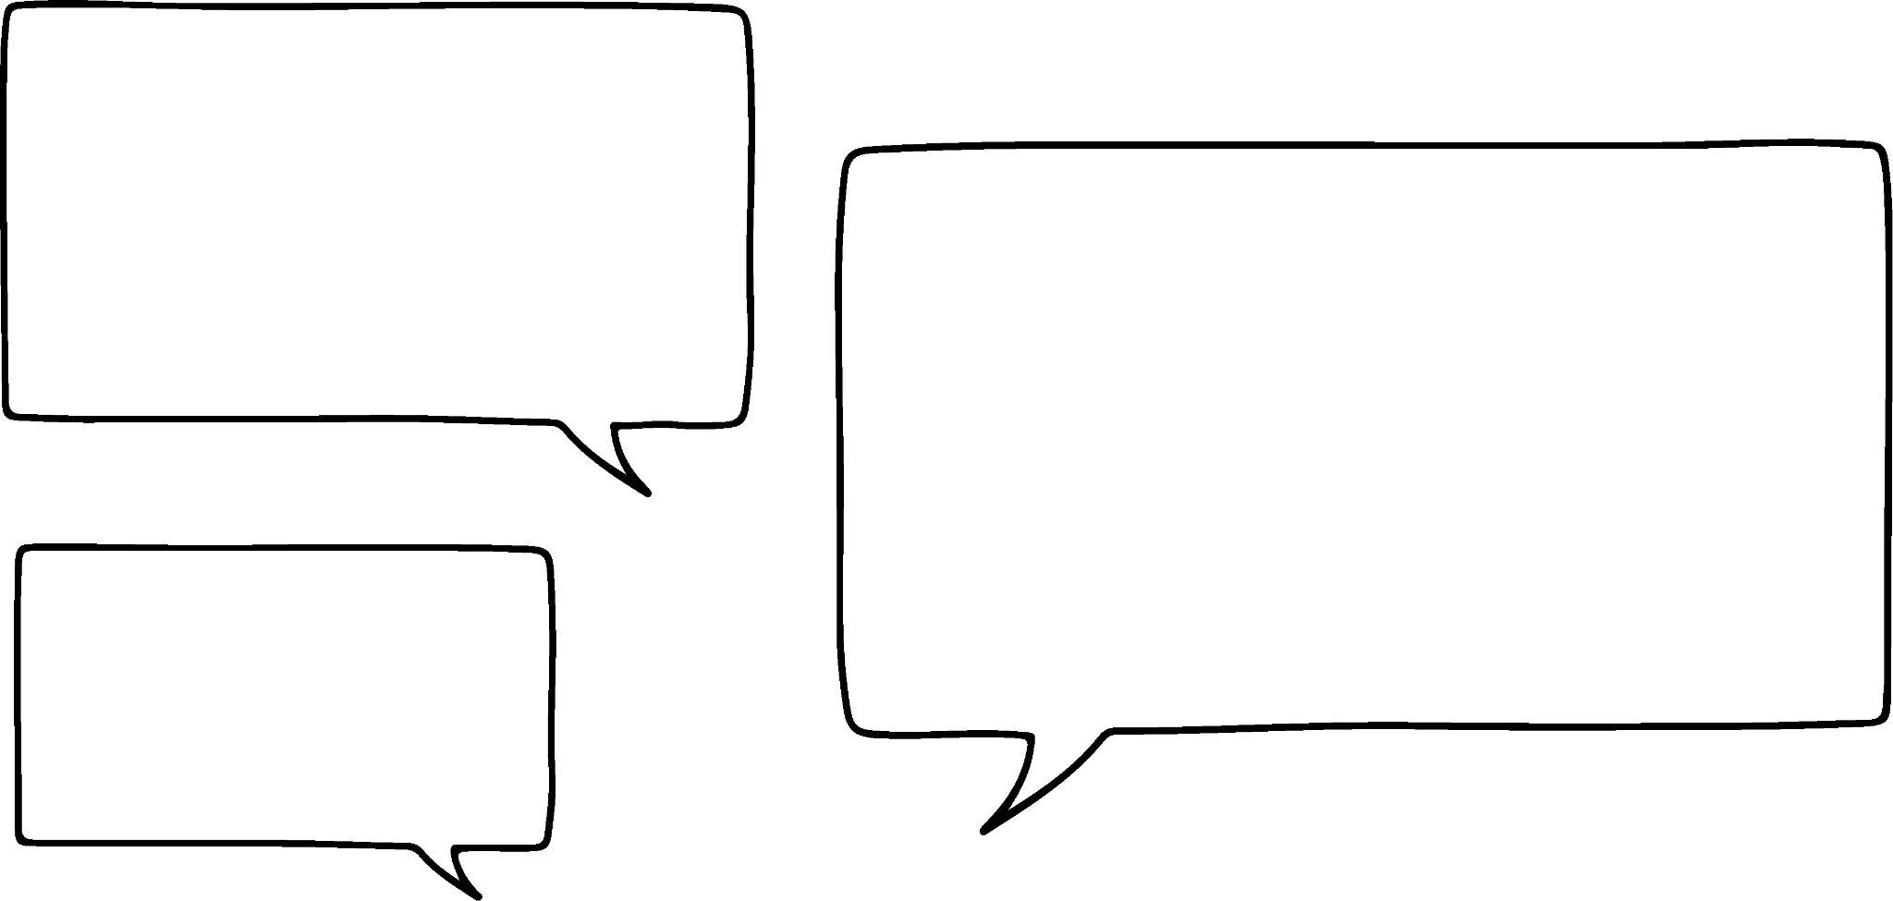

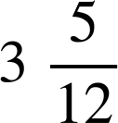


Addition and subtraction involving mixed numbers
Laura and Andeep are talking about how much time they spent on their homework last week.
I spent hours
I spent hours
Laura
Andeep
How much longer did Andeep spend on his homework?
hour

Slide 7


Addition and subtraction involving mixed numbers
What number is the arrow pointing at?

Slide 8
Addition and subtraction involving mixed numbers
What number is the arrow pointing at?

Slide 9
Addition and subtraction involving mixed numbers
What number is the arrow pointing at?

Slide 10
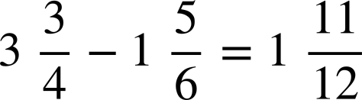
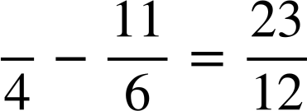
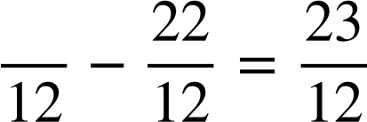
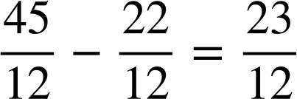
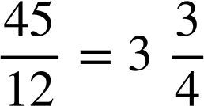
Addition and subtraction involving mixed numbers
What digit is missing in this calculation?

Slide 11
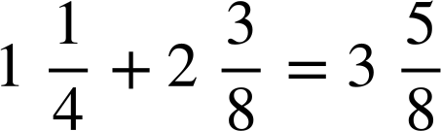
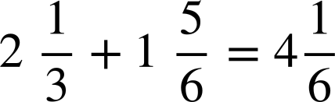
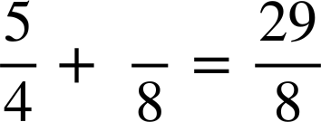
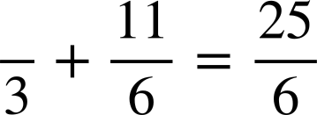
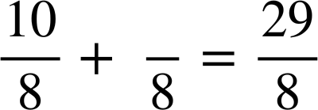
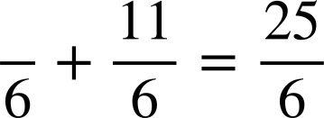
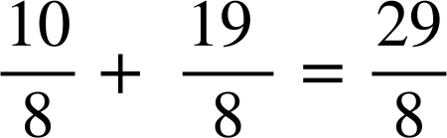
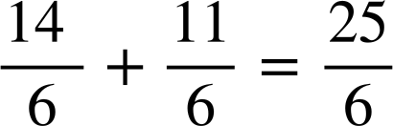
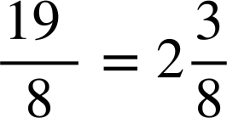
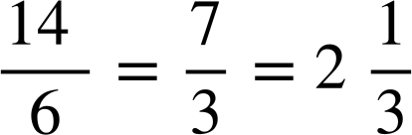
Addition and subtraction involving mixed numbers
What digit is missing in this calculation?
What digit is missing in this calculation?

Slide 12
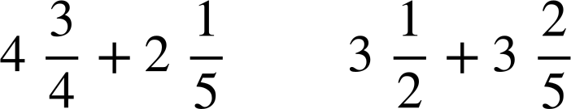
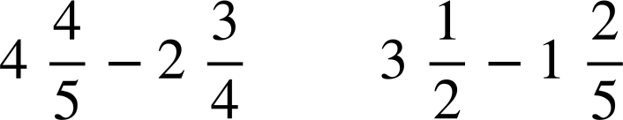
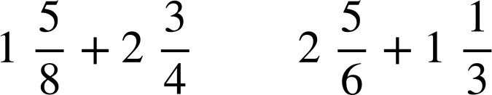
Addition and subtraction involving mixed numbers
1) By calculating the value of each side complete the inequality statement by placing a < or > between them.
a)
b)
c)

Slide 13

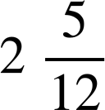




Addition and subtraction involving mixed numbers
2) Find the missing value in each diagram. Give your answer as a mixed number in its simplest form.
a)
b)
c)
?
?
?
d)
e)
f)
?
?
?

Slide 14
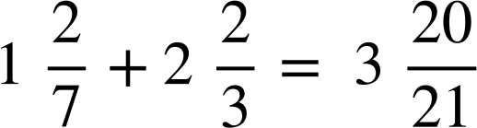
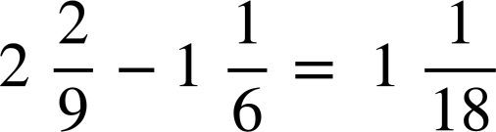
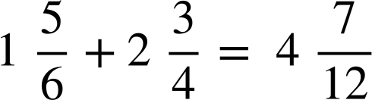
Addition and subtraction involving mixed numbers
3) Find the missing digits:
a)
b)
c)

Slide 15
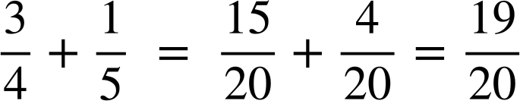
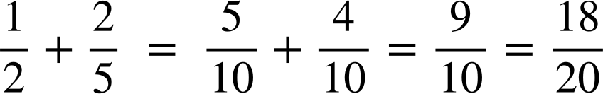
Addition and subtraction involving mixed numbers
1) By calculating the value of each side complete the inequality statement by placing a < or > between them.
a)
>
4 + 2 = 6 and 3 + 3 = 6 so I just need to compare the fractional sum in each calculation.

Slide 16
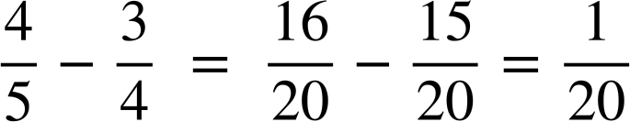
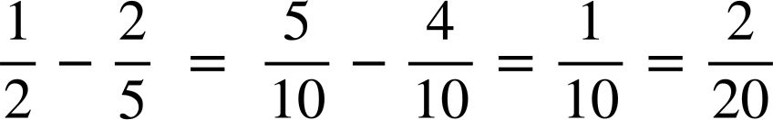
Addition and subtraction involving mixed numbers
1) By calculating the value of each side complete the inequality statement by placing a < or > between them.
b)
<
4 − 2 = 2 and 3 − 1 = 2 so I just need to subtract the fractional parts in each calculation.

Slide 17
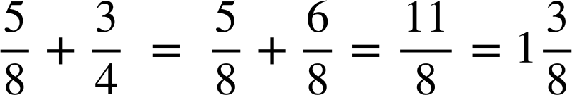
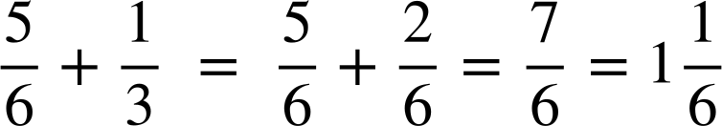
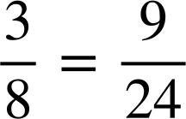
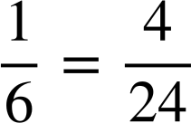
Addition and subtraction involving mixed numbers
1) By calculating the value of each side complete the inequality statement by placing a < or > between them.
c)
>
1 + 2 = 3 and 2 + 1 = 3 so I just need to compare the fractional sums.

Slide 18
Addition and subtraction involving mixed numbers
1) By calculating the value of each side complete the inequality statement by placing a < or > between them.
a)
b)
c)
>
<
>

Slide 19
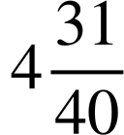

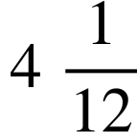
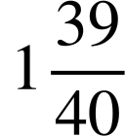
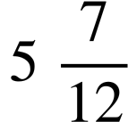
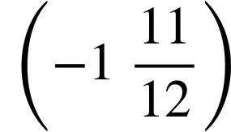
Addition and subtraction involving mixed numbers
2) Find the missing value in each diagram. Give your answer as a mixed number in its simplest form.
a)
b)
c)
?
?
?
d)
e)
f)
?
?

Slide 20
Addition and subtraction involving mixed numbers
3) Find the missing digits:
a)
b)
c)

Slide 21
Securing understanding of addition and subtraction with fractions
Addition and subtraction involving mixed numbers
Efficient calculation strategies

Slide 22
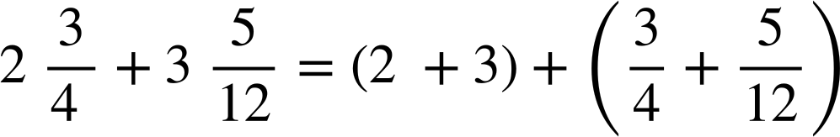
Efficient calculation strategies
How long did they spend on homework in total?
I spent hours
I spent hours
Laura
Andeep
=
Are these equivalent?
Yes, as they use the commutative law.

Slide 23
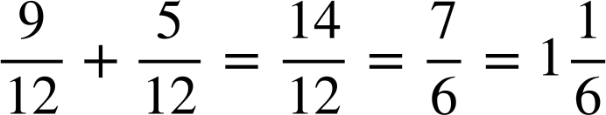
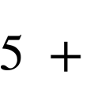

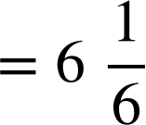
Efficient calculation strategies
We can find the sum of the integers and fractions separately and then find the sum of those.
=

Slide 24
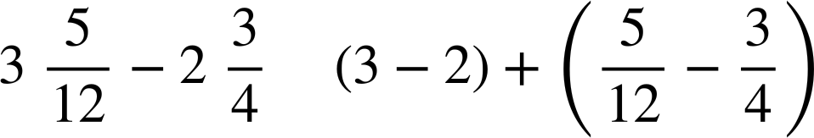
Efficient calculation strategies
Let’s go back to this problem
I spent hours
I spent hours
Laura
Andeep
How much longer did Andeep spend on his homework?
=
Are these equivalent?
Yes, as they use the commutative law.

Slide 25
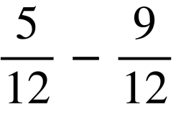
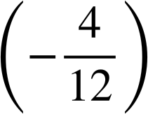
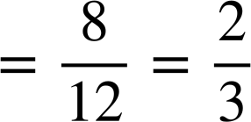
Efficient calculation strategies
We can find the difference of the integers and fractions separately and then find the sum of those.
=

Slide 26
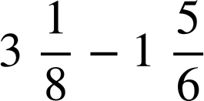
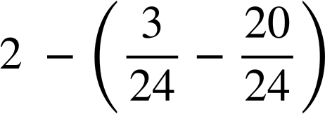
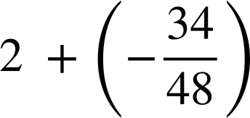

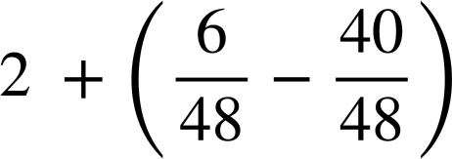
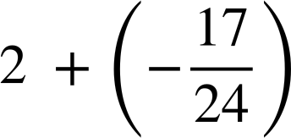




Efficient calculation strategies
Identify the correct and most efficient step in each in each column.
A
A
A
B
B
B
C
C
C

Slide 27





Efficient calculation strategies
Laura and Andeep are working out the answer to:
What is the same and what is different about their calculations?
Laura noticed that can be simplified to before calculating.
Laura
Andeep

Slide 28





Efficient calculation strategies
Sort the following into the most efficient method.
Simplify first
LCM

Slide 29










Efficient calculation strategies
a)
d)
g)
h)
b)
e)
c)
f)

Slide 30








Efficient calculation strategies
a)
d)
g)
h)
b)
e)
i)
c)
f)

Slide 31
Securing understanding of addition and subtraction with fractions
One method for adding and subtracting mixed numbers is to convert the mixed numbers to improper fractions and find a common denominator.
E.g.
Converting to improper fractions is not always the most efficient way of adding and subtracting mixed numbers.
An alternative method is to deal with the integers and fractions separately.
E.g.
=

Slide 32

© Oak National Academy 2023.
Produced in partnership with Mathematics in Education and Industry.
Licensed on the Open Government Licence v3.0, except where otherwise stated. See Oak terms and conditions.

